Slide 1
Employee Management System
Using spring boot and react
Chitti Yamunasri

Slide 2
Table of contents
Abstract
Introduction
Related works
Project overview
System features
Technologies
Implementation
Conclusion

Slide 3
Abstract
The Employee Management System project aims to streamline employee management with features like project visibility, team assignments, and self-registration. It automates onboarding, performance evaluation, and payroll processing, enhancing efficiency through a centralized platform for seamless communication and data management.

Slide 4

Introduction:
Building a Comprehensive Employee Management System with React and Spring Boot

Slide 5
Real-Time Applications of EMS
Automated Onboarding: Efficiently streamline the employee onboarding process through automated workflows, reducing manual tasks and ensuring a seamless experience for new hires.
Project Tracking: Track and manage project progress in real-time, allocate resources effectively, and ensure timely completion by utilizing EMS integrated project tracking tools.
Performance Reviews: Conduct regular performance evaluations to assess employee growth and development, provide feedback, and set goals for continuous improvement.

Slide 6
Software Components
Operating System: Preferable options include Windows OS or a modern Linux distribution for optimal performance and compatibility.
Programming Languages: Utilize Java and JavaScript to ensure robust and dynamic functionality within the system.
Database Management System: Integrate MySQL for reliable data storage, retrieval, and management within the system.
API Development and Testing Tools: Employ Postman for seamless API development, testing, and monitoring to enhance system performance.

Slide 7
Overview of Employee Management Systems
Centralized Platform: A singular hub for managing all employee-related tasks, enhancing operational efficiency.
Reduced Administrative Burdens: Automated processes leading to decreased manual workload and increased productivity.
Improved Data Accuracy: Enhanced precision in employee data management, reducing errors and enhancing decision-making.
Task assignment improvement: Employee analysis of the task assignment and completion

Slide 8



Key Features of the Employee Management System
Project Management: Efficiently organize and track projects from initiation to completion for improved productivity.
Team Assignment: Assign tasks and responsibilities to teams seamlessly, ensuring clarity and accountability.
Employee Self-Registration: Streamline the onboarding process by allowing employees to register and update their information independently.

Slide 9
Key Libraries and Technologies: Enhancing Employee Management System with Advanced Technologies
Spring Boot for backend development: Spring Boot provides a robust framework for efficient backend development, offering features like auto-configuration and easy deployment.
React for frontend development: Utilizing React for frontend ensures a dynamic and interactive user interface, simplifying the development of complex UI components.
MySQL for data management: MySQL serves as a reliable database management system, facilitating secure and scalable data storage for the employee management system.
Postman for API testing: Postman streamlines API testing processes, enabling thorough testing of endpoints and ensuring the reliability and functionality of the employee management system.

Slide 10

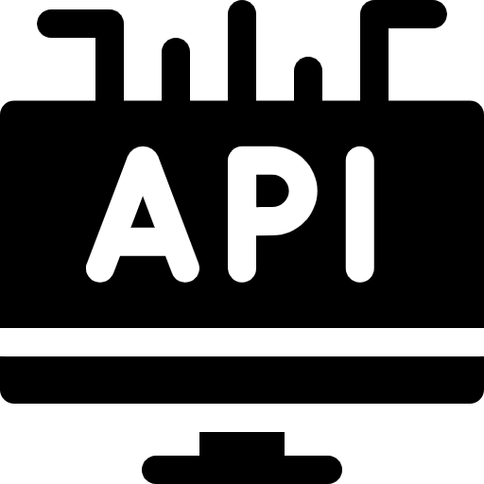

Components in Employee Management System
User Authentication and Authorization: Secure access control to ensure data privacy and system security.
Project Dashboard: Visual representation of project progress and milestones for effective tracking.
Employee Dashboard: Personalized interface for employees to manage tasks, performance, and goals.
Performance Tracking: Monitor and evaluate employee performance to drive continuous improvement.

Slide 11




Flow of the Project
Problem Definition: Identifying the issues and gathering relevant information to guide the project.
System Architecture Design: Planning and structuring the system layout for optimal performance and scalability.
Deployment and Maintenance: Implementing the system and ensuring ongoing support and updates for seamless operation.
Security Implementation: Incorporating robust security measures to safeguard data and prevent unauthorized access.

Slide 12
Features and Functionality:
Manager Capabilities: Enables Project Management, Team Assignment, and Data Access for seamless oversight and coordination.
Employee Capabilities: Facilitates Self-Registration, Project Participation, and Attendance Tracking to empower employees and streamline operations.

Slide 13
Implementation
Frontend Running at Port 3000:The system user interface is accessible via a web browser at port 3000 for seamless interaction.
Backend Running at Port 8000: The server-side logic and database operations run at Port 8000, handling data processing and management.

Slide 14


Frontend Implementation
Create React App: Initiate the project by setting up a React application to build the frontend interface.
EmployeeForm Component: Develop a component to manage employee details and interactions within the system.
EmployeeList Component: Design a component to display and manage the list of employees in the system.

Slide 15



Frontend Implementation
TaskForm Component: Create a component to handle task-related inputs and actions for employees.
TaskList Component: Build a component to exhibit and manage the list of tasks assigned to employees.
Login Component: Implement a component to facilitate secure user authentication and login functionality.

Slide 16
Backend Implementation
Create a maven project: Initiate a new Maven project to manage dependencies and build processes efficiently.
Define dependencies in pom.xml: Specify necessary dependencies in the project Object Model file to integrate essential libraries and tools.

Slide 17
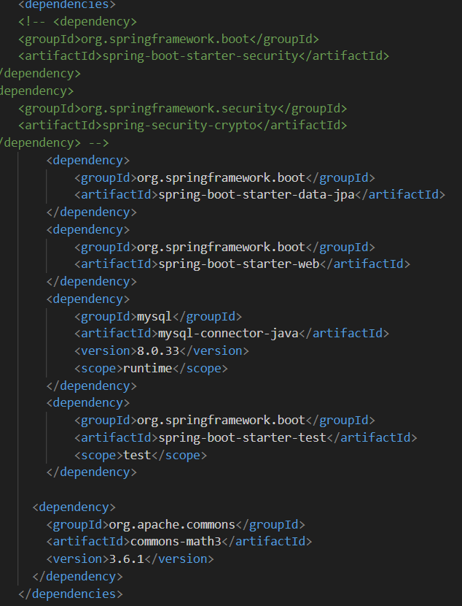
Pom.xml dependencies:

Slide 18
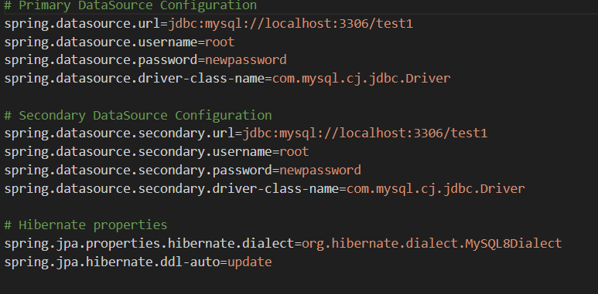
Configure backend details in application.properties

Slide 19
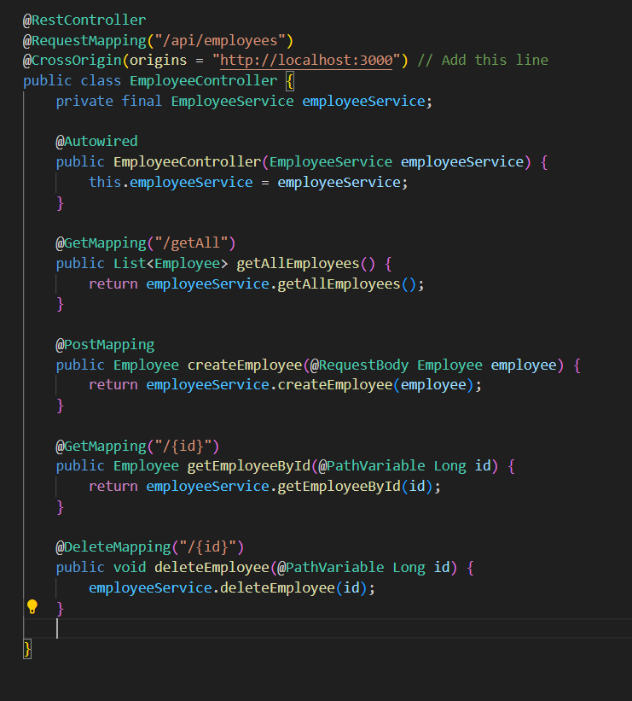
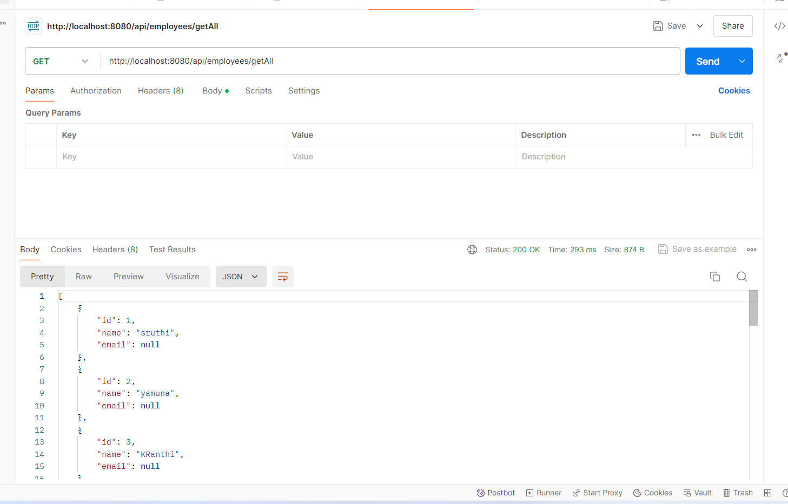
Define API calls:

Slide 20
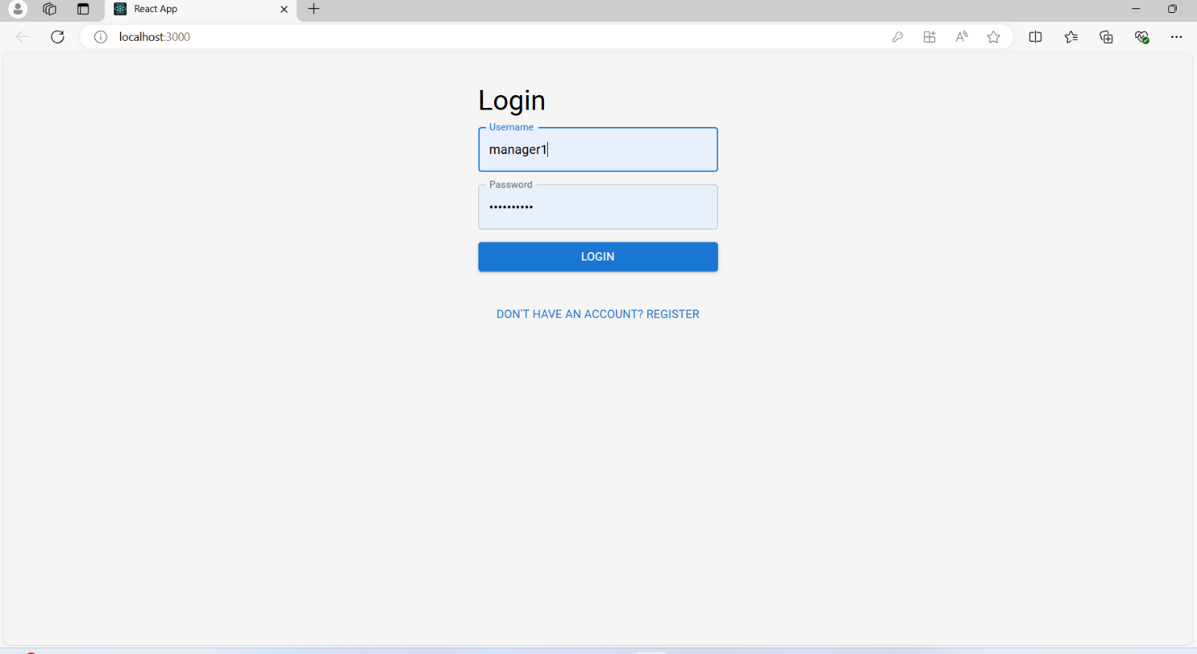
Execution
Login page

Slide 21
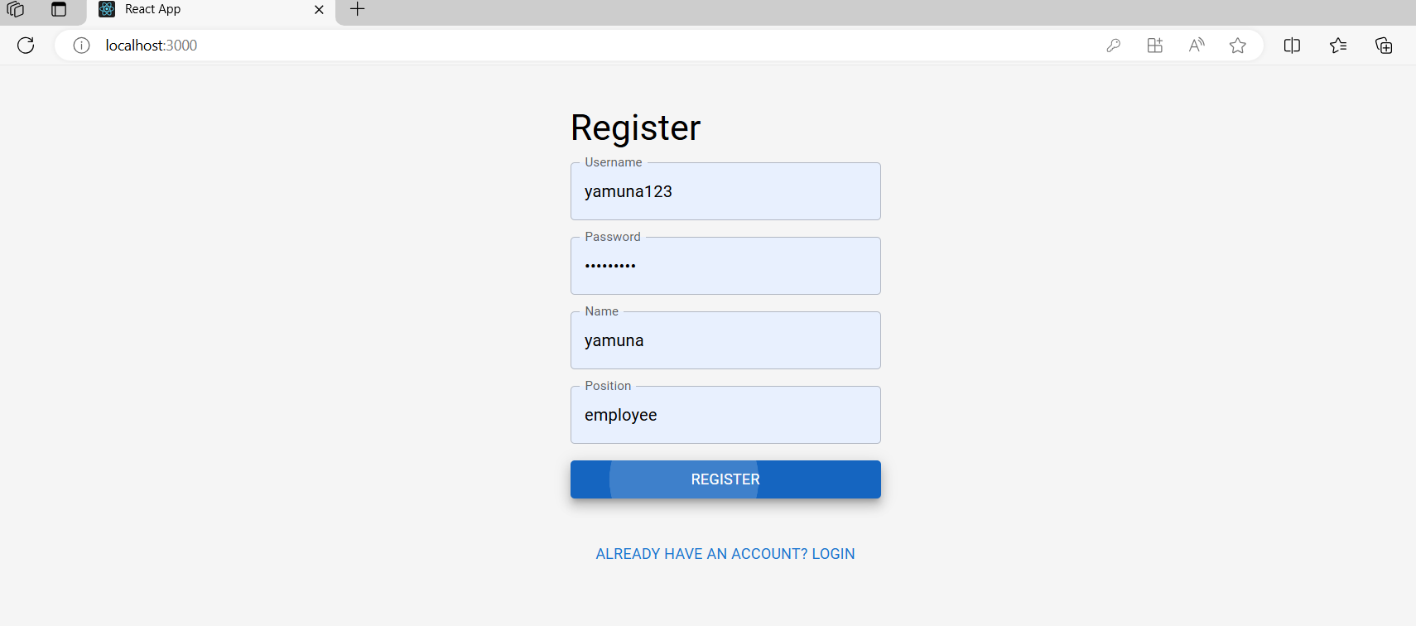
Register when a new employee is hired

Slide 22
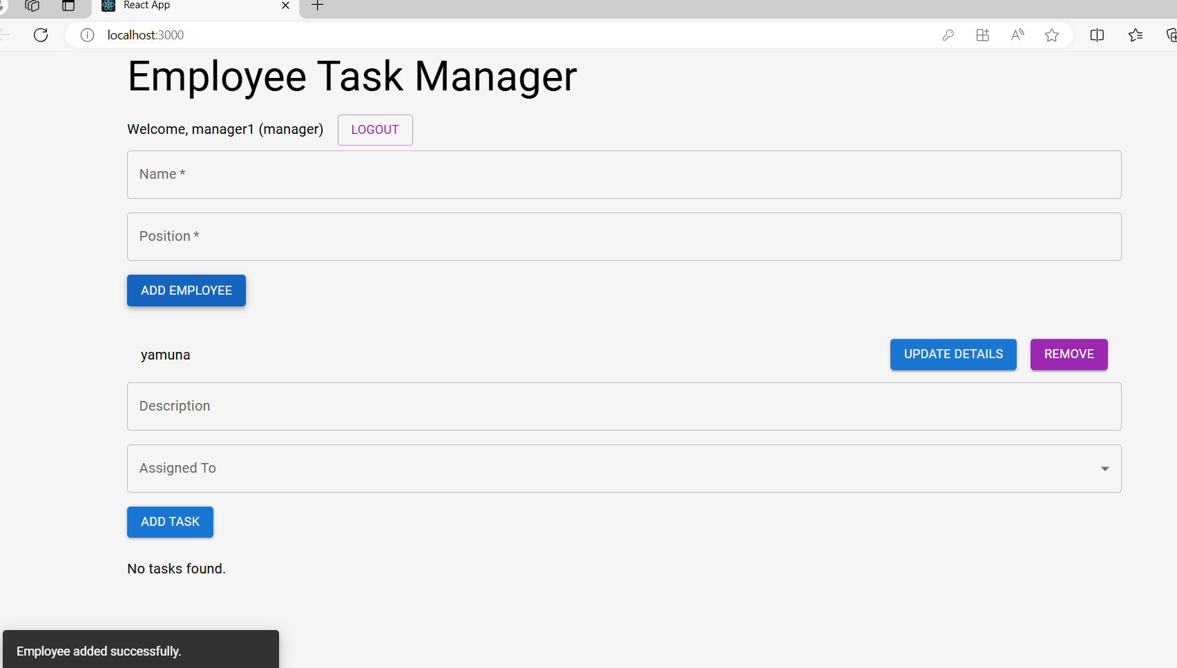
When manager add new employee

Slide 23
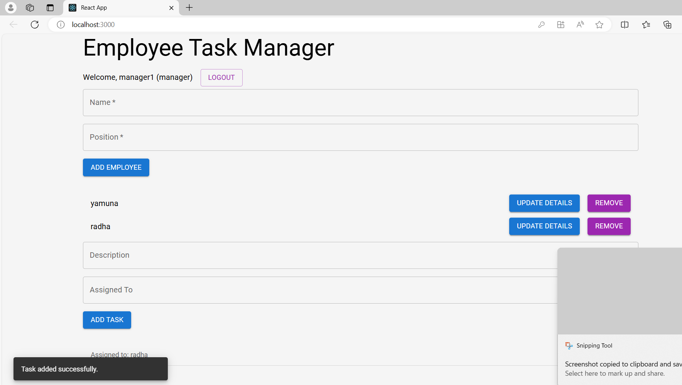
Managers can assign tasks to employee

Slide 24
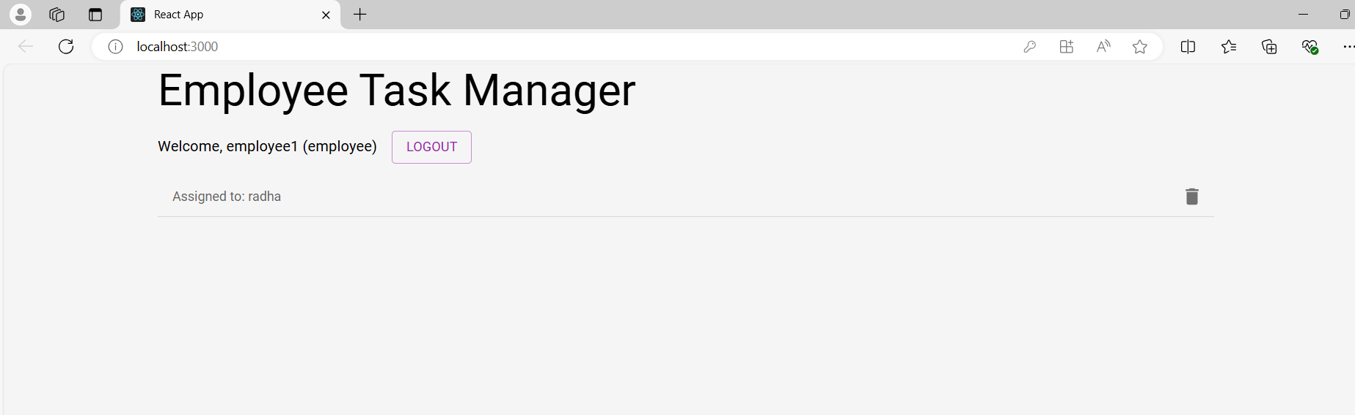
Employee interface

Slide 25
Conclusion
Developing a comprehensive Employee Management System (EMS) presents a significant opportunity to enhance organizational efficiency, improve employee satisfaction, and streamline HR processes. By leveraging advanced technologies such as AI and automation, an EMS can easily manage employee data, track performance, and handle administrative tasks. Overall, a well-designed Employee Management System has the potential to transform HR operations, making them more efficient, transparent, and aligned with organizational objectives.

Slide 26
Future Scope
Integration with Other Business Systems
Unified Platforms: Creating more unified platforms that integrate EMS with other enterprise systems like Customer Relationship Management (CRM), Enterprise Resource Planning (ERP), and Learning Management Systems (LMS).
Mobile and Remote Work Optimization
Mobile-First Solutions: Developing EMS applications that are optimized for mobile devices to accommodate remote and on-the-go employees.
Remote Work Management: Tools and features to manage remote work, including time tracking, productivity monitoring, and virtual collaboration tools.

Slide 27
References
Courses (blackboard.com)
Learn Spring Boot Tutorial - javatpoint
Getting Started – React (reactjs.org)

